Slide 1
Investigate Customer Buying Patterns
Ubiqum DATA 107 Ber Modul 1
1. Spending by region. Which do spend most / least?
2. Age of customers between regions. Prediction
3. Correlation age ~ online transaction
4. Correlation number of items ~ amount spent

Slide 2
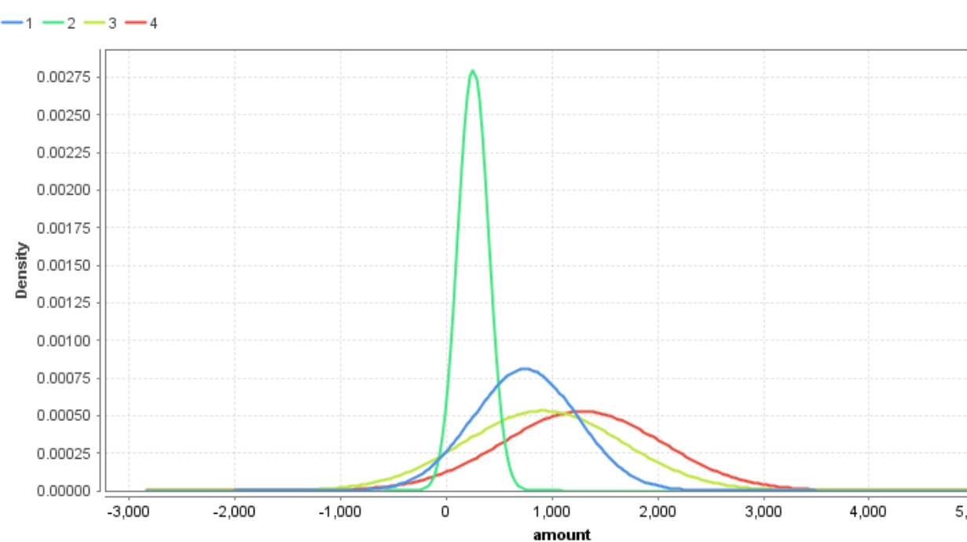
Spending by Region 1 / 3
The region in which a transaction is made serves as a good indicator for how much will the customer spend

Slide 3
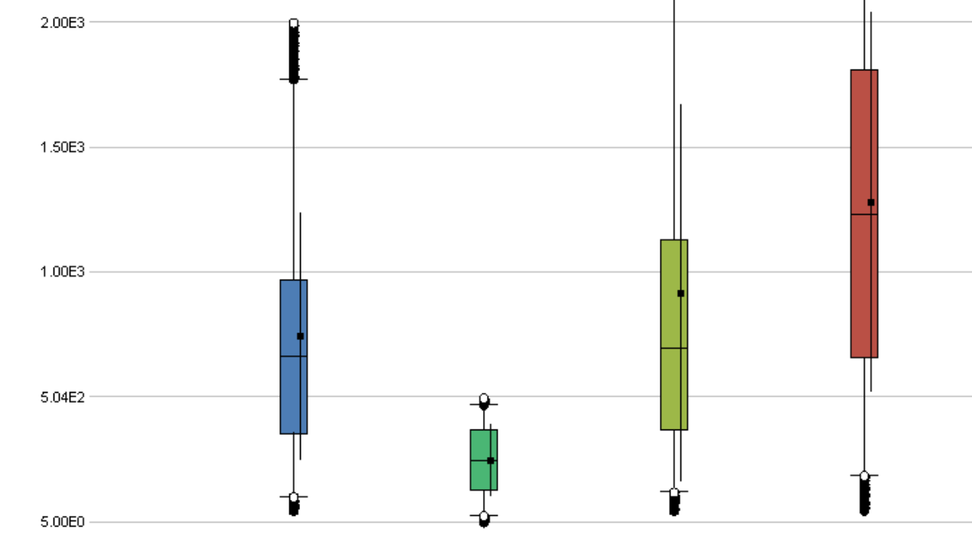
Spending by Region 2 / 3
The region in which a transaction is made serves as a good indicator for how much will the customer spend.

Slide 4
Spending by Region 3 / 3
The typical customer in region 2 spends the least, the practical totality of the purchases being under 500$ with an average around 250$.
The customers from region 4 spend the most, almost all of them spending between 200$ and 2700$ around an average of 1300$. One of every two customers spend between 700$ and 1800$

Slide 5
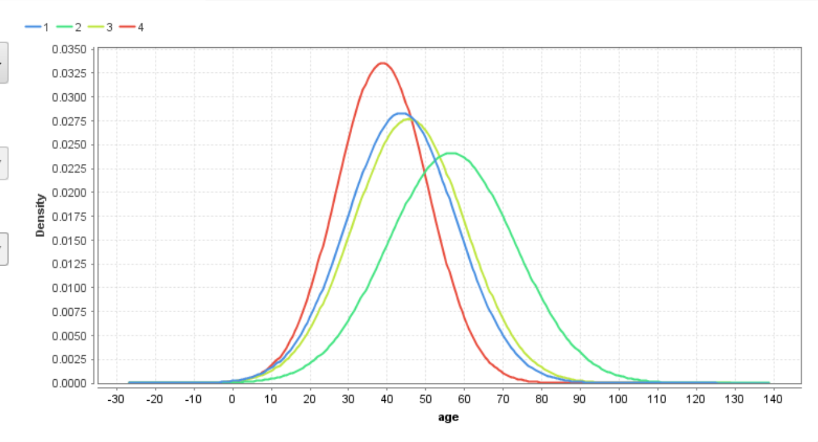
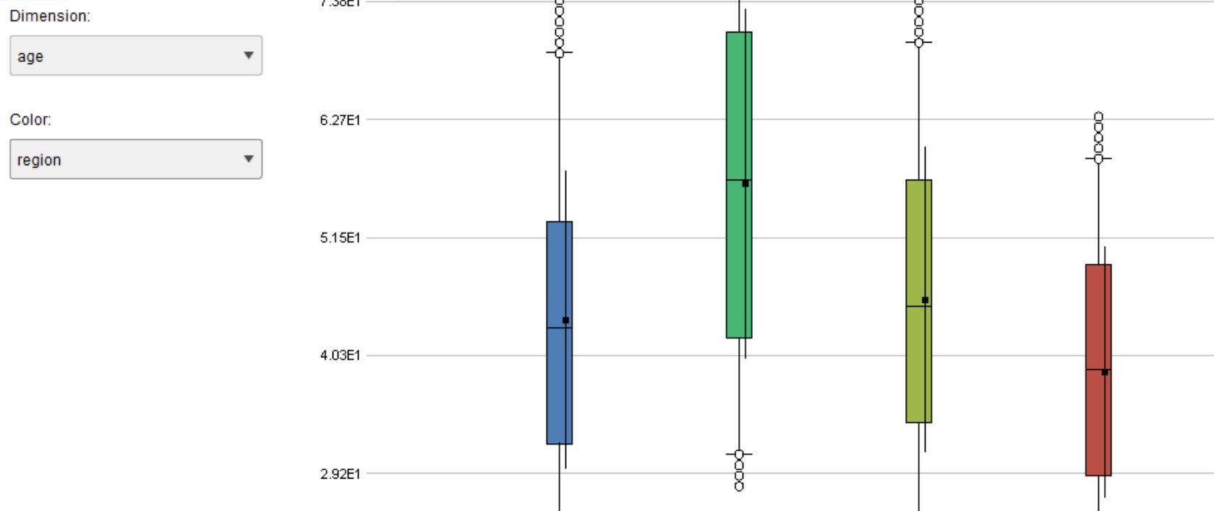
Age of customers btw regions 1 / 2
There are some clear differences regarding age and region

Slide 6
Age of customers btw regions 2 / 2
Region 4 has the youngest customers aged in average 40 years old, the half of them being between 30 and 50 y.o.
Region 1 and 3 have a very similar customers age distributon, with an average around 45 years old. and half of the customers being between 35 and 55 y.o.
Region 2 has elderlier customers, in average about 55 years old, and the half of them being between 40 and 70 y.o.
Region is the best predictor for the customers age, and predicting accurately the age in a given region taking other information in account is in general not possible.

Slide 7
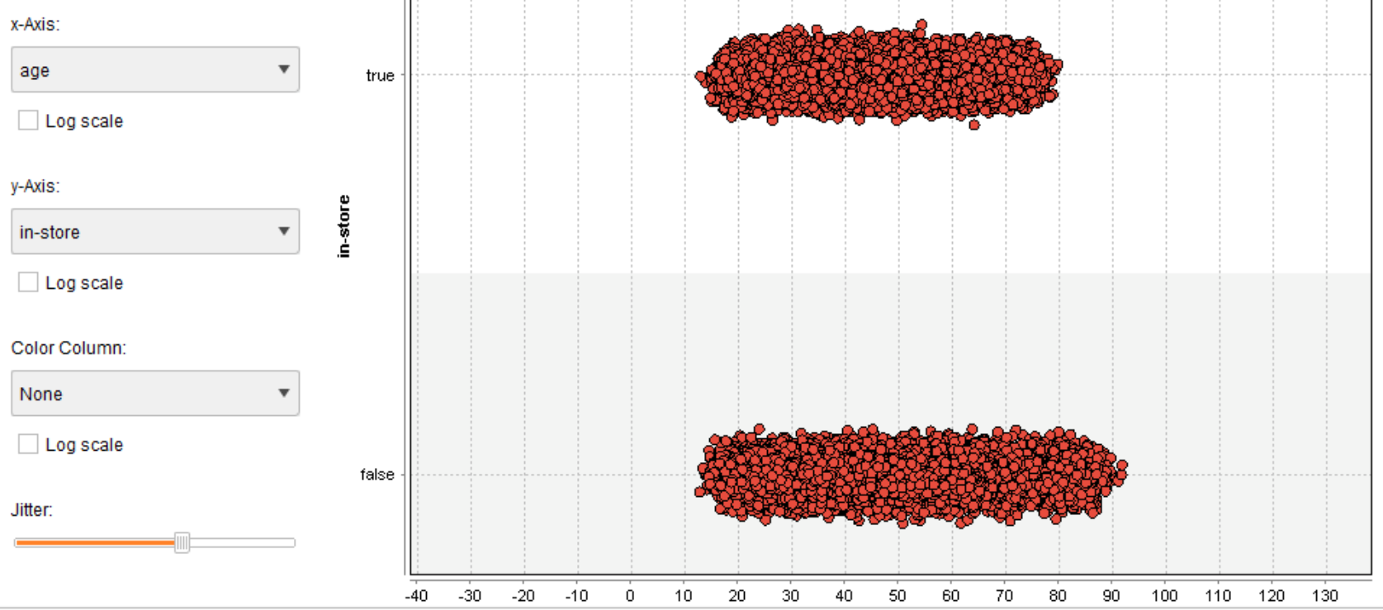
Correlation age ~ online translation 1 / 1
there is no correlation between customers age and their inclination to buy online
exceptuating that the ones aged over 78-80 y.o. make their shopping exclusively online

Slide 8
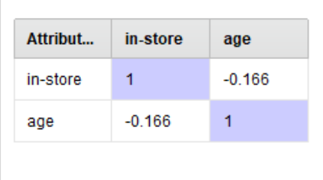
Correlation age ~ online transaction 2 / 2

Slide 9
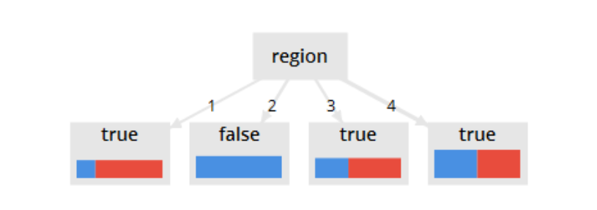
Relation region ~ online transaction
The principal factor for buying online or in-store is the region
Customers in region 1 will buy mostly in-store (80%) and the ones
In region 2 they will do it almost all online

Slide 10
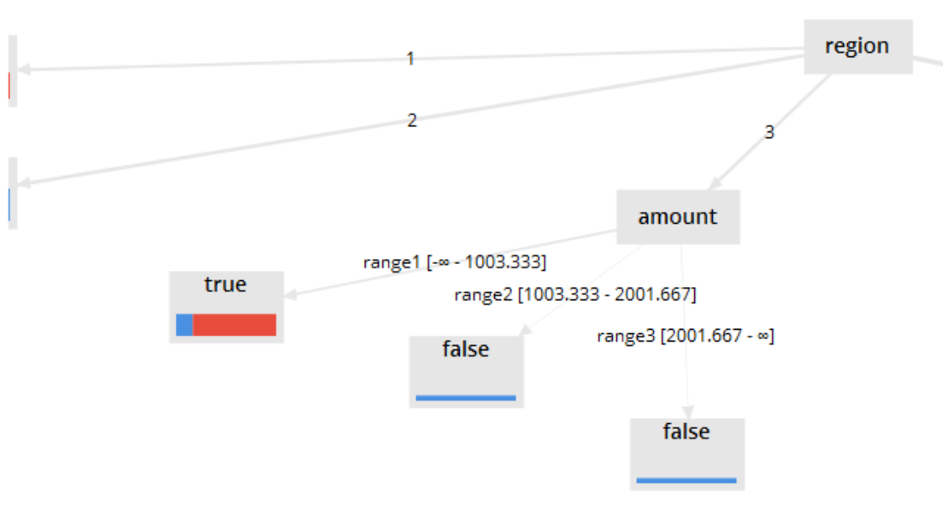
Region, amount, age ~ online transaction
For some regions other useful factors will be:
  the spent amount
In region 3, if the amount of the purchase is under 1000$, it will be done in the store in 85% of the cases
If the amount is higher it will be done almost certainly online

Slide 11
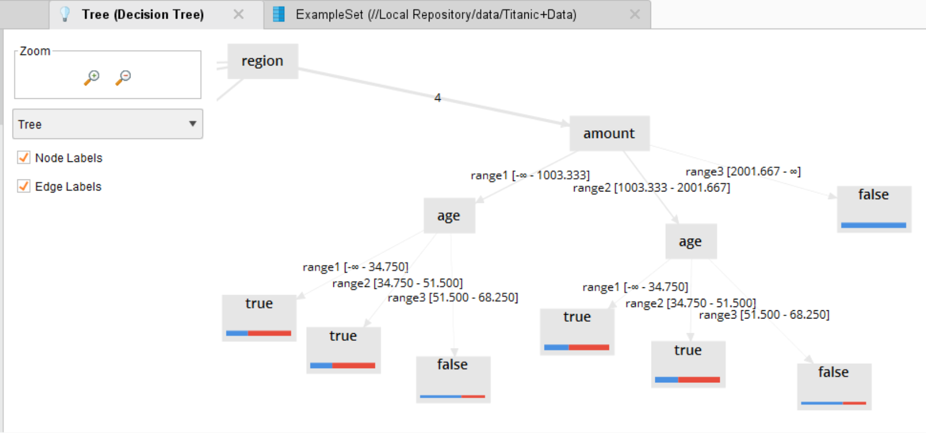
Region, amount, age ~ online transaction
For some regions other useful factors will be:
  the spent amount & the costumer's age
In region 4, if the amount of the purchase is over 2000$, it will be done almost always online
If the purchase is below 2000$, the decision will depend on the age of the customer: 3 out of 5 will prefer the online option if they are over 50 y.o.
if they are younger, more probably (60%) they prefere to buy it in-store

Slide 12
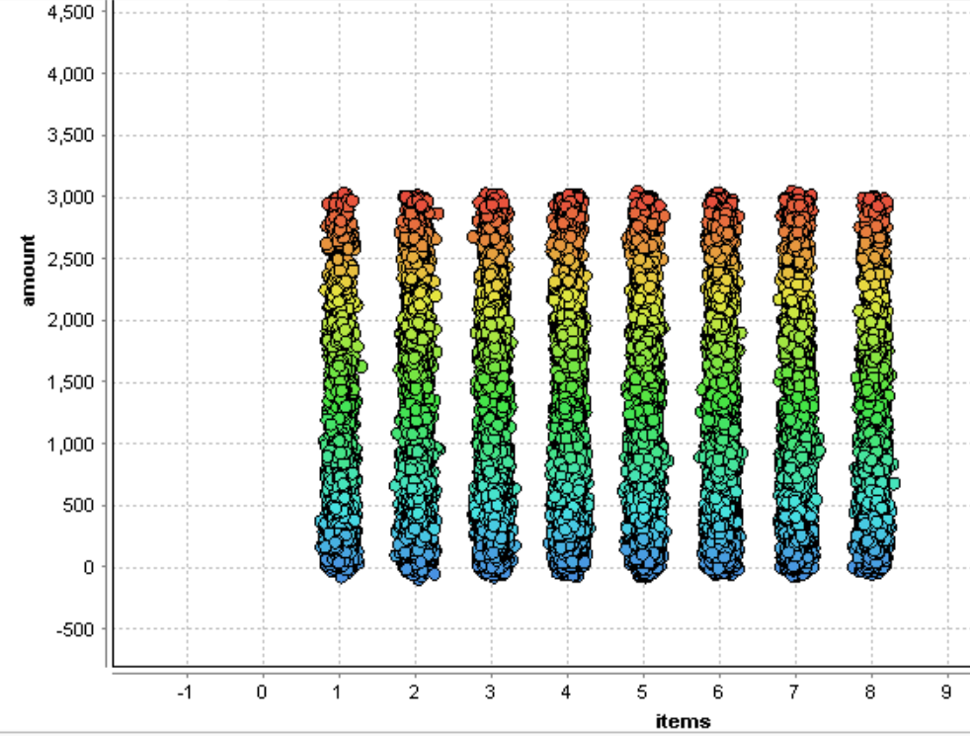
Relation number of items ~ amount spent
There is no correlation between the number of items purchased and the amount spent

Slide 13
thank you!
...I am the last one of my species

